Slide 1
How to submit your results?
Presentation available at
goo.gl/Dvkb4B

Slide 2
Shiny App for submission
http://176.31.253.205/shiny/mediation-challenge/shiny-app/

Slide 3
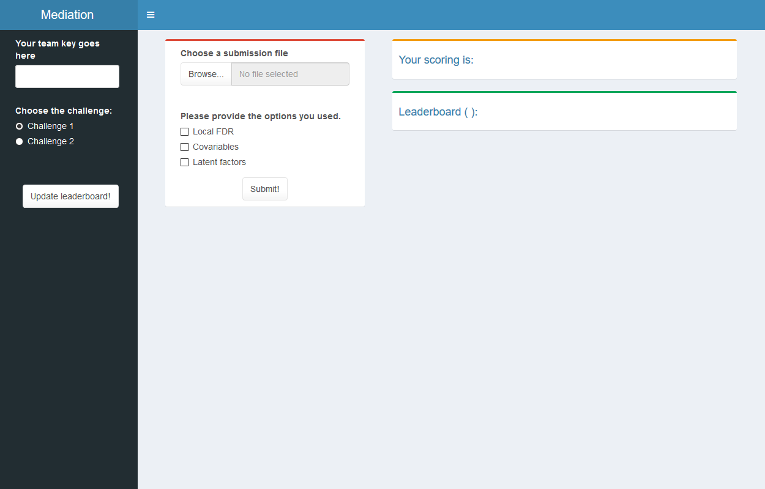

Slide 4
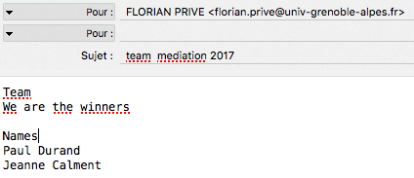

Get your KEY
Form a team (1 to 3 people)
Email with
The name of your team
The names of the people
in the team
We will answer with your team key
Then copy and paste it in

Slide 5
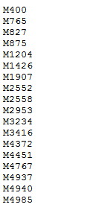

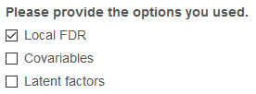


File of submission
File: one marker per line (use write in R)
Browse it
Provide the options you used
Submit (to the right challenge)

Slide 7




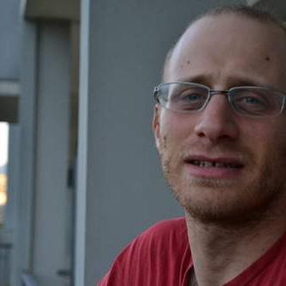
Questions?
Florian PRIVÉ
Keurcien LUU
Kevin CAYE
Bug in submission
Shiny
Server hosting Shiny app
R related to mediation
Other R questions
Michael BLUM
Olivier FRANÇOIS

